Slide 1

THREE NUGGETS
Batch 12 , Group D

Slide 2
Today’s Presentation
Introduction
Marks vs Knowledge
Andhra Pradesh Problems Ka Swadesh
Smart People Do Smart Work
Conclusion

Slide 3
Introduction
This is part of a Design Thinking (DT) project. The DT challenge is to raise the approval rating of the AP state government to 90%.
The steps We took to prepare these nuggets and this PowerPoint are we have taken a nugget and the information we heard or saw from people .

Slide 4
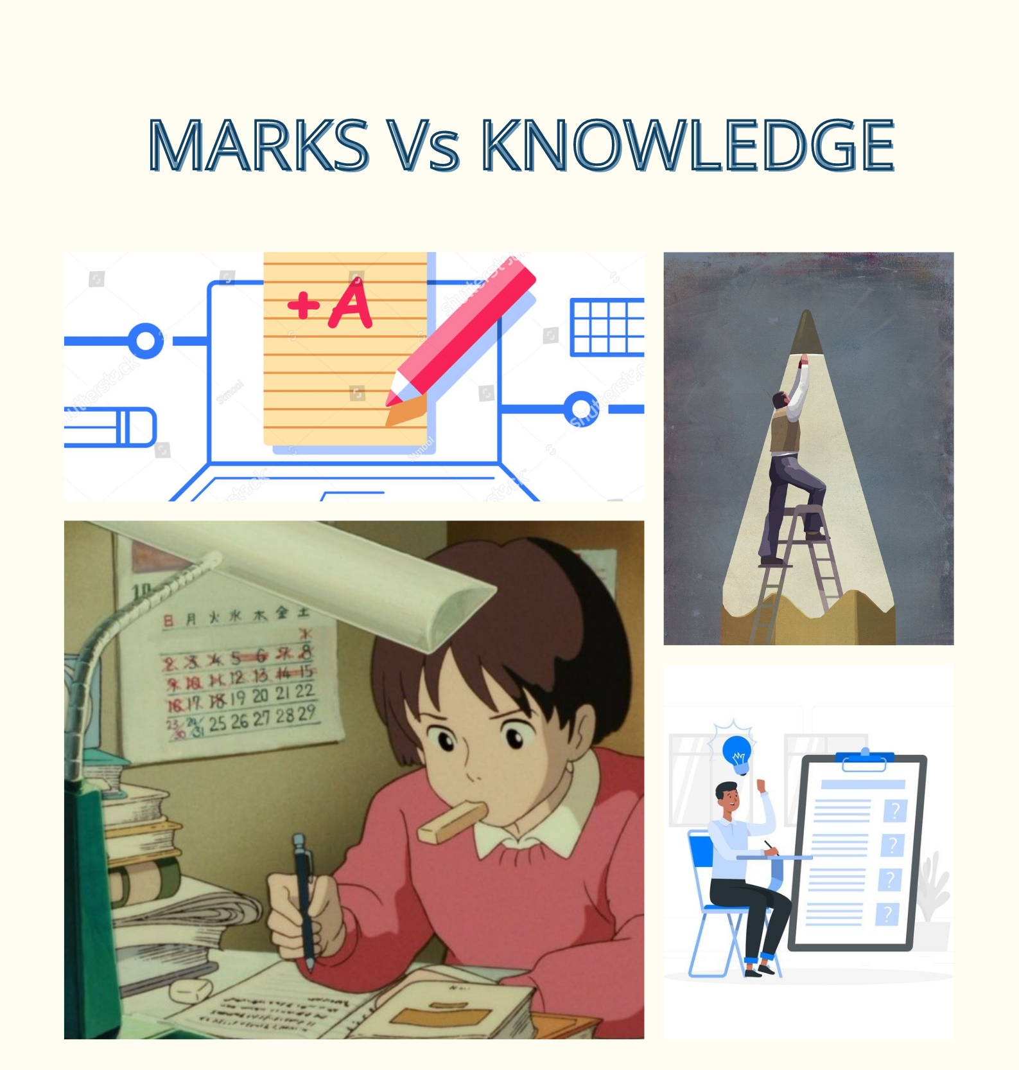
Marks Vs Knowledge
Insight: Marks and Grades are too important than the knowledge in the present days.
Evidence: I saw a number of students memorizing the subject matters without proper understanding the content.
Movie-Style Title:
MARKS VS KNOWLEDGE
Poster: student mugging up for examinations with out understanding the concepts.

Slide 5
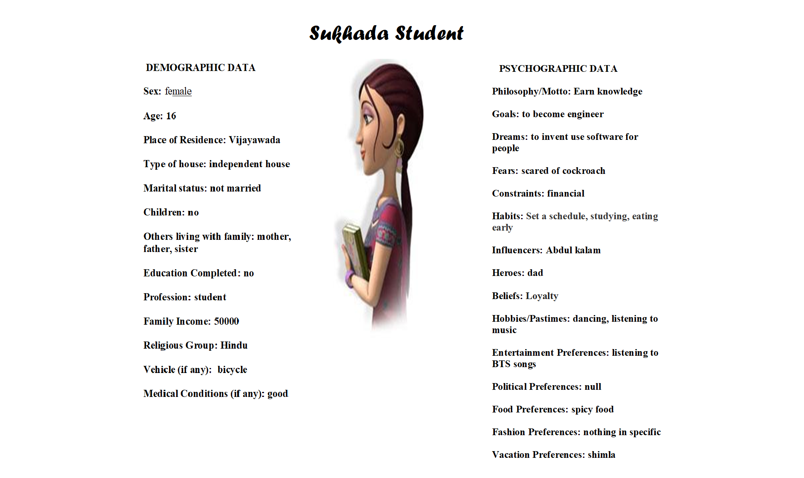

Slide 6
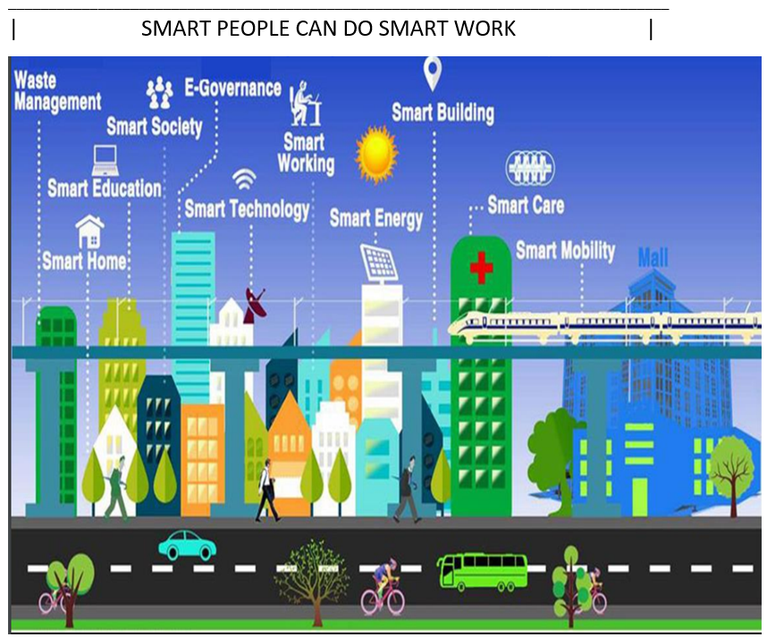
SMART PEOPLE DO SMART WORK
INSIGHT:
Smart Cities make everything inside them and around them SMART!
EVIDENCE:
I saw my friends who living in smart cities they getting smart education in this Pandemic.
My Professor’s are living in smart cities and using smart technology to teach us.
AP government is trying to build a smart city in Amaravati.
MOVIE-STYLE TITLE: SMART PEOPLE DO SMART WORK
POSTER:
The People Living In Smart City’s are enjoying by using Facilities.
Smart Cities make people lives better.

Slide 7

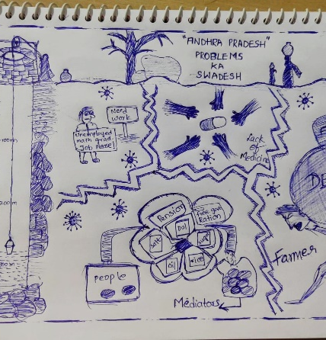
Andhra Pradesh Problems Ka Swadesh
INSIGHT: People are not getting proper facilities provided by the government
EVIDENCE: I heard that all the schemes provided by the government doesn’t reach the people
I saw that people are not getting proper facilities like ration, jobs, pensions medical facilities on time.
MOVIE-STYLE TITLE: Andhra Pradesh Problems Ka Swadesh
POSTER:
This poster conveys that some people are not getting the proper facilities, provided by the Government due to mediators and lack of knowledge.

Slide 8
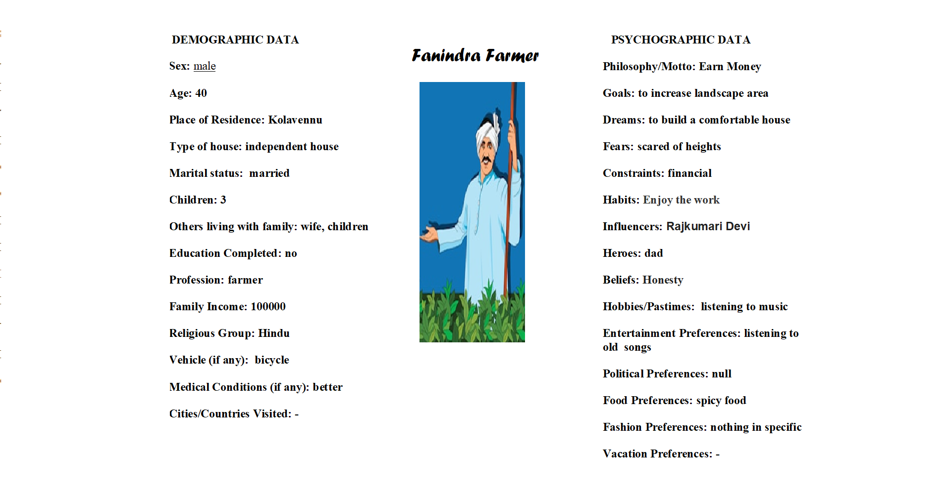

Slide 9
Conclusion
Our team learned
About the importance of insights in Design Thinking like the sensible way to solve a problem.
About the right way to define and document an insight in a nugget form.

Slide 10
Thank You…! 👍
From Batch – 12 Project – D

